Slide 1


Mental health in tech survey analysis
ITCS 6156-001 Machine Learning
Guided by: Dr. Atif Farid Mohammad
Group 6: Jaya Sindhura. Sadam
Neela Ayshwaria Alagappan
Akhila Vemana
Srinath Muralinathan

Slide 2
Project Idea Inspiration
The idea behind this project is to analyze mental health of technology employees to categorize deadly disease.
Collect data across globe relating to mental health and perform exploratory data analysis and create visualizations.
Observe insights from visualization created using ML tools and techniques to draw conclusion on deadly mental diseases around the world.
Some questions worth exploring:
How does the frequency of mental health illness and attitudes towards mental health vary by geographic location?
What are the strongest predictors of mental health illness or certain attitudes towards mental health in the workplace?

Slide 3
Introduction to Dataset and implementation
OSMI Mental Health in Tech - Survey
Currently over 1300 responses, the ongoing 2016 survey aims to measure attitudes towards mental health in the tech workplace and examine the frequency of mental health disorders among tech workers.
The dataset is taken from Kaggle, https://www.kaggle.com/osmi/mental-health-in-tech-survey.
The dataset contains 27 fields like Timestamp Age, Gender, Country, family history , treatment ,work interference, seek help, benefits, care options, mental health consequence, obs_consequence
The project is implemented using python jupyter notebook and visualization of analysis is carried out in tableau.

Slide 4
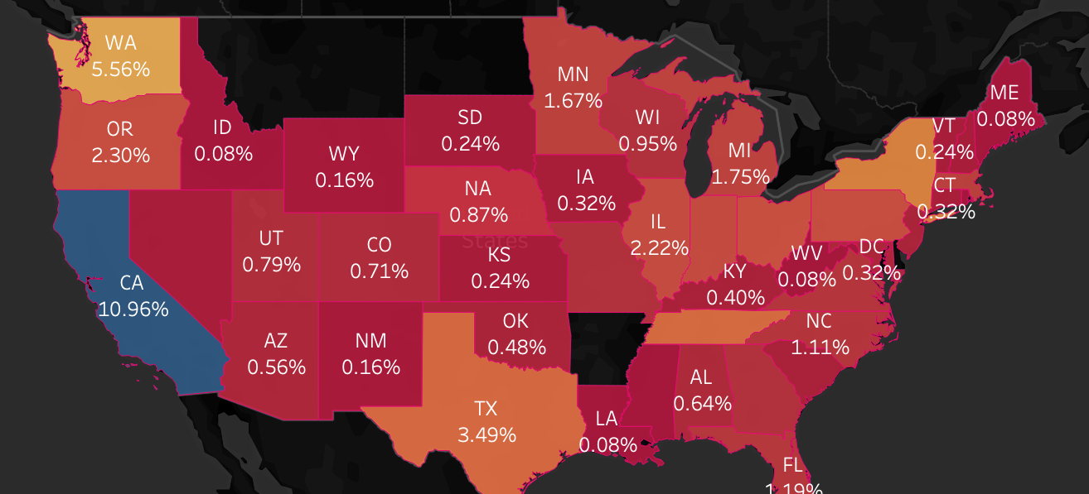
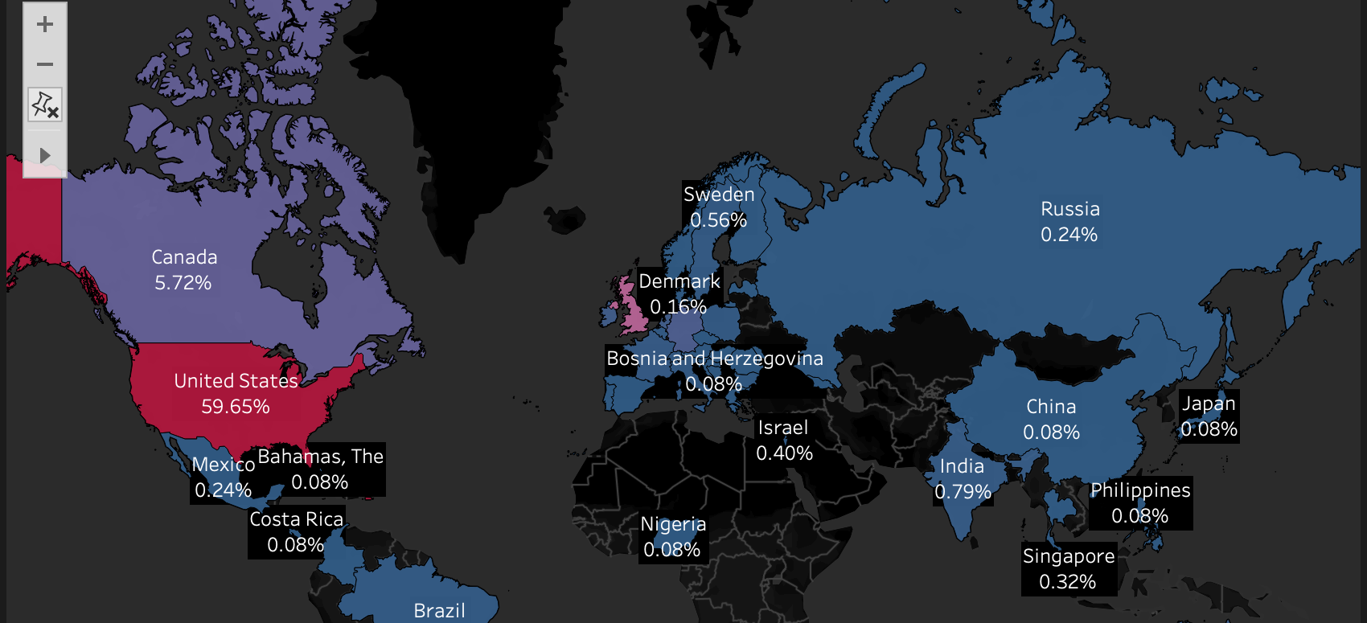
Exploring the dataset

Slide 5

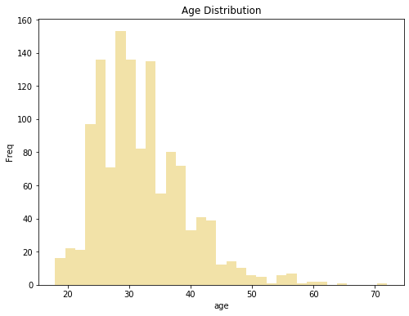
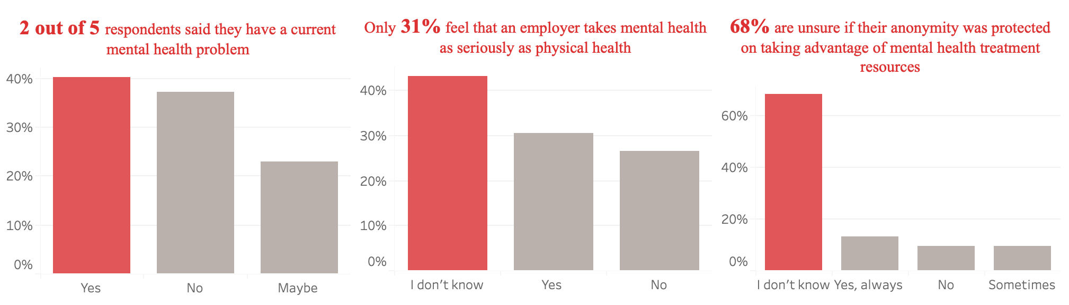
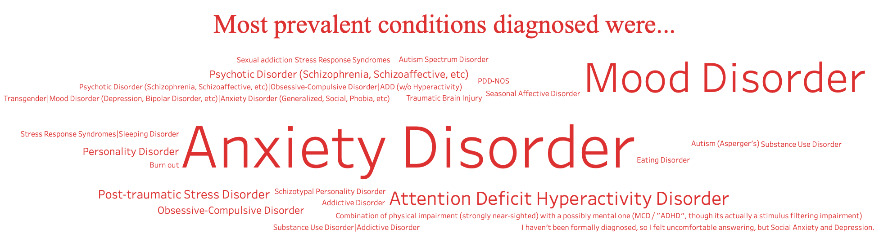
Exploring the dataset
It was observed that people between 25-30 years have highest frequency of mental issues.
2 out of 5 respondents said they have a current mental health problem
Only 31% feel that an employer takes mental health as seriously as physical health
68% are unsure if their anonymity was protected on taking advantage of mental health treatment resources
Most prevalent conditions diagnosed were Anxiety Disorder and Mood Disorder

Slide 6
Data cleaning
Missing values: state 515 , self employed 18, work interfere 264 and comments 1095.
Treating missing values : dropping , replacing with substitution, mean and mode
Cleaning Nan's : Assign default values for each data type default Int = 0 default String = ‘Nan' default Float = 0.0
Replacing missing values: There are only 0.014% of self employed so change Nan to NOT self-employed
There are only 0.20% of work interfere so let's change Nan to "Don't know

Slide 7
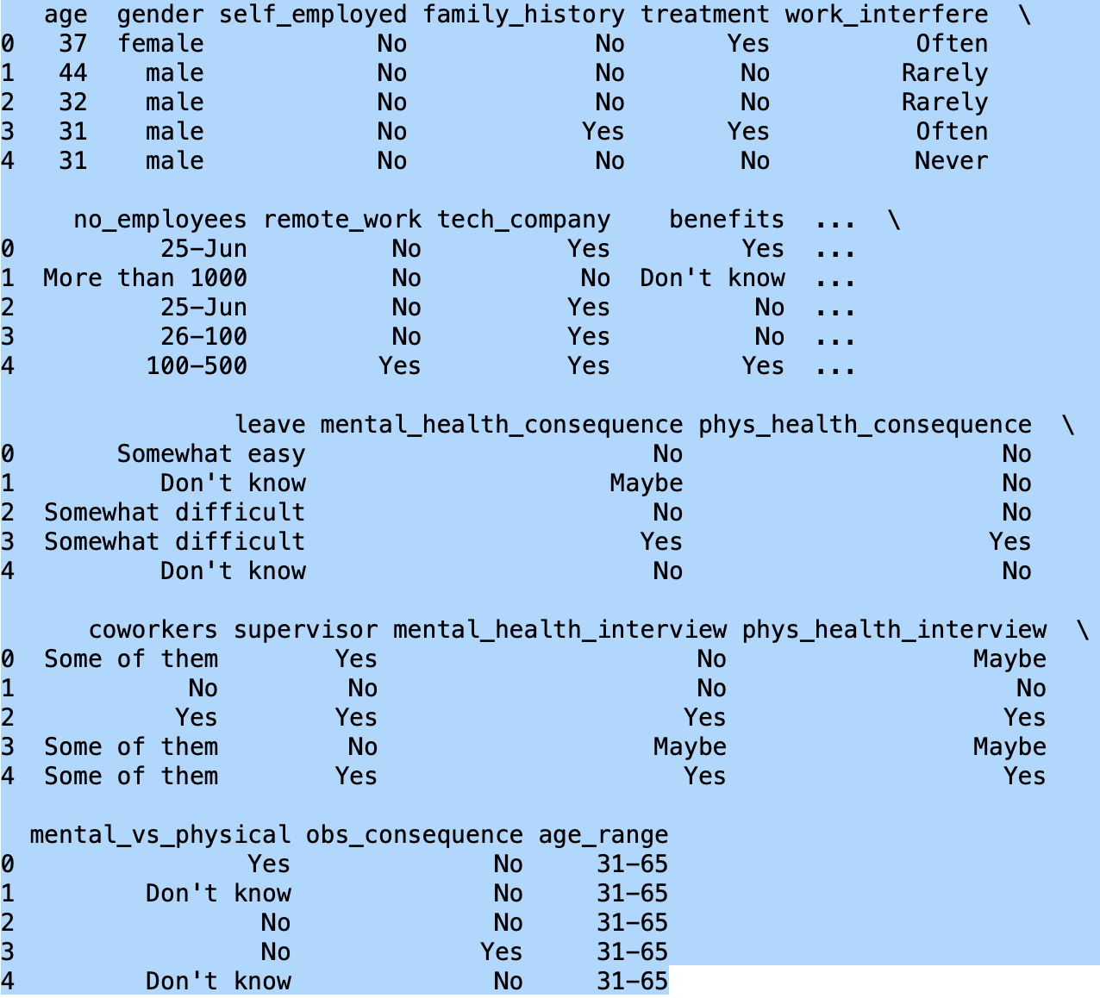
Data pre-processing
Synchronizing column headers: train_df.columns = map(str.lower, train_df.columns)
Cleaning Gender and Age fields:
Gender groups are created with 3 groups like male, female and trans.
Similarly Age buckets are created in the groups 0-20,21-30,31-65 and 66-100

Slide 8
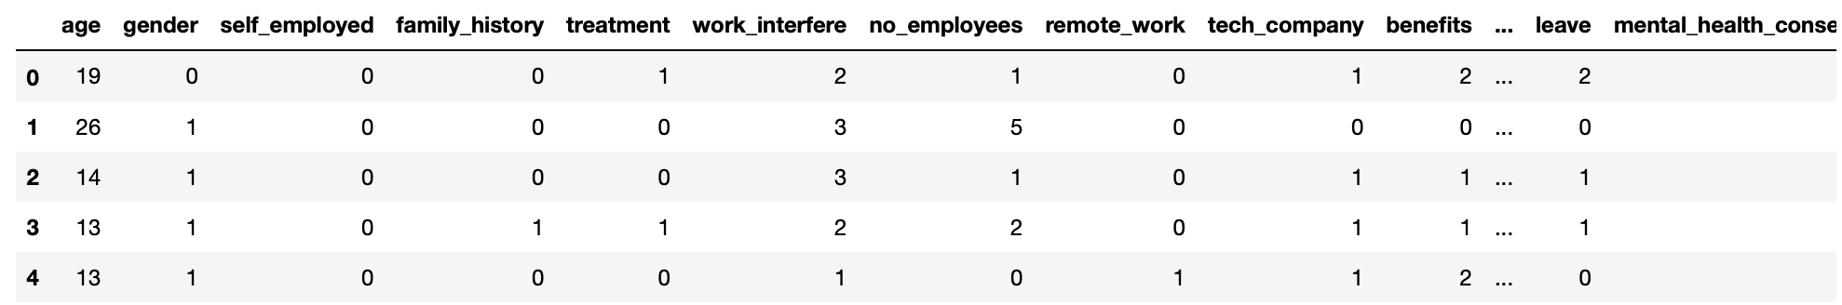
Label Encoding
Label encoding is done to convert categorical text data into model-understandable numerical data
Import used from sklearn.preprocessing import LabelEncoder
Dataset after Label encoding

Slide 9
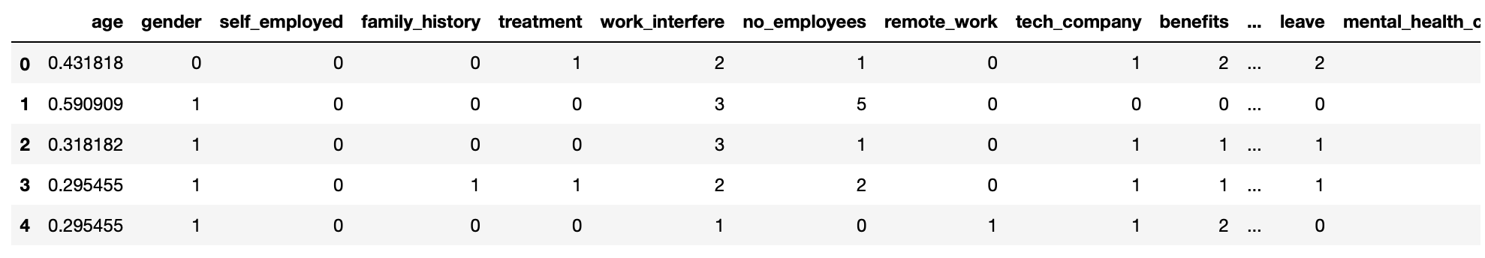
Features Scaling
feature scaling: It basically helps to normalize the data within a particular range.
from sklearn.preprocessing import MinMaxScaler
Features Scaling age, because is extremely different from the others
scaler = MinMaxScaler()
train_df['age'] = scaler.fit_transform(train_df[['age']])
train_df.head()
Final Dataset after feature scaling

Slide 10
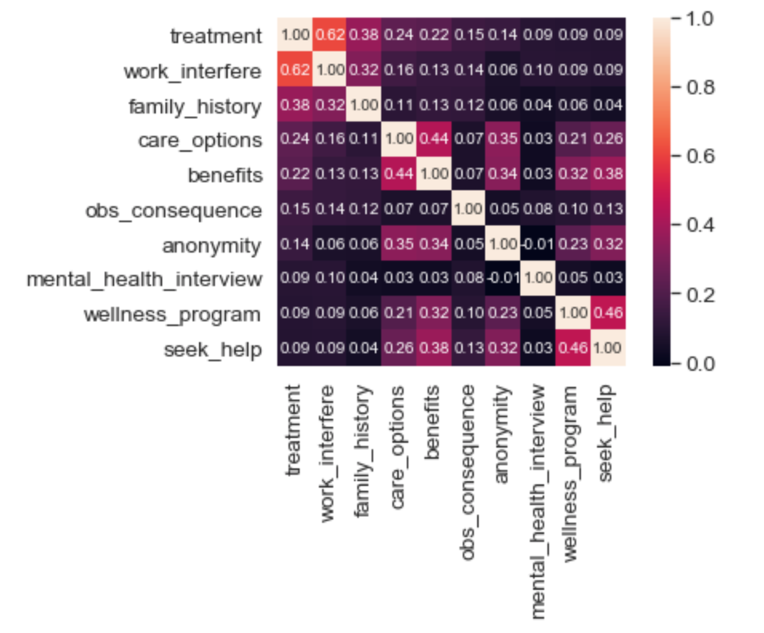
Covariance Matrix. Variability comparison between categories of variables

Slide 11
Modelling
predict whether a patient should be treated of his/her mental illness or not according to the values obtained in the dataset
Spliltting the dataset: define X and y
feature_cols = ['age', 'gender', 'family_history', 'benefits', 'care_options', 'anonymity', 'leave', 'work_interfere’]
X = train_df[feature_cols]
y = train_df.treatment
split X and y into training and testing sets
X_train, X_test, y_train, y_test = train_test_split(X, y, test_size=0.30, random_state=0)
Since the dataset had categorical variables, supervised learning method was employed.
Three different modelling techniques were applied to the cleaned and preprocessed dataset.
Logistic Regression
Decision Trees
Random Forest

Slide 12
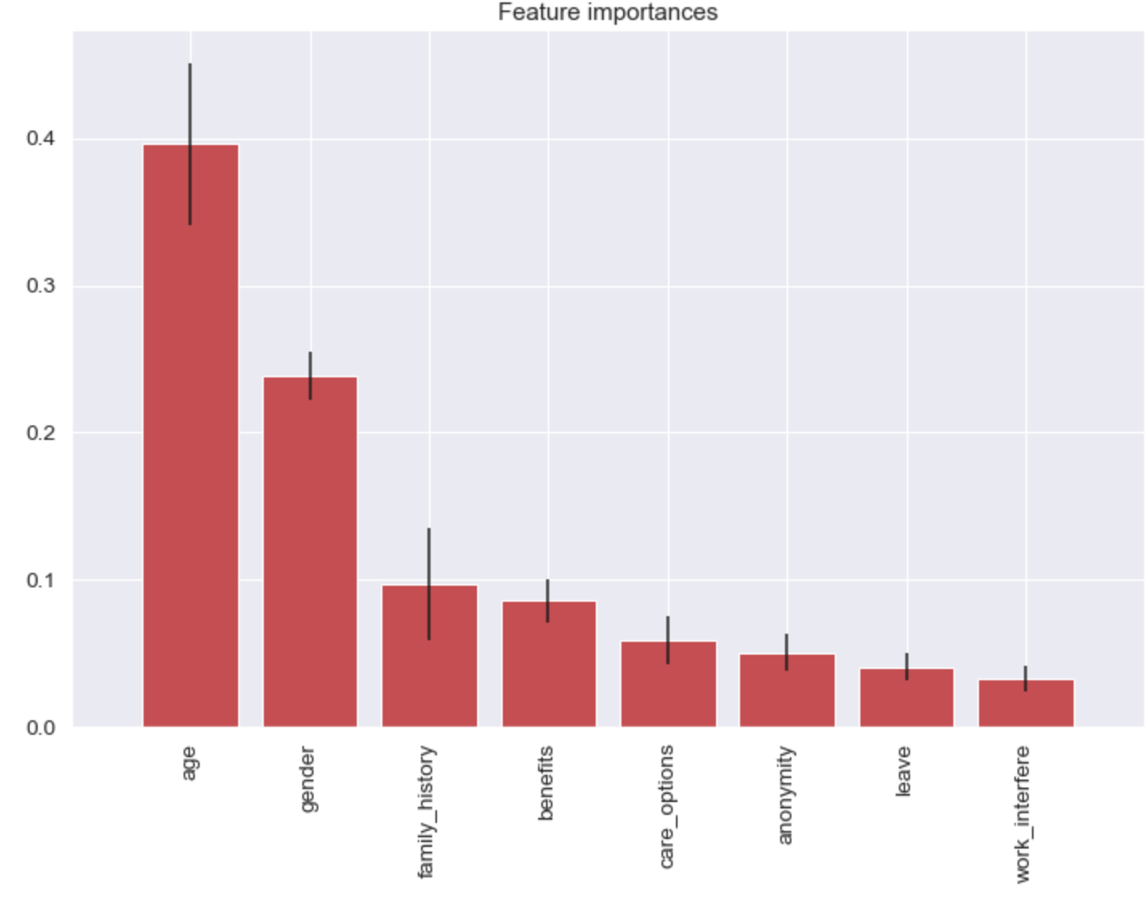
Feature Importance
Feature importance is calculated as the decrease in node impurity weighted by the probability of reaching that node. The node probability can be calculated by the number of samples that reach the node, divided by the total number of samples. The higher the value the more important the feature
Forest was built to compute the feature importance.
from sklearn.ensemble import ExtraTreesClassifier

Slide 13
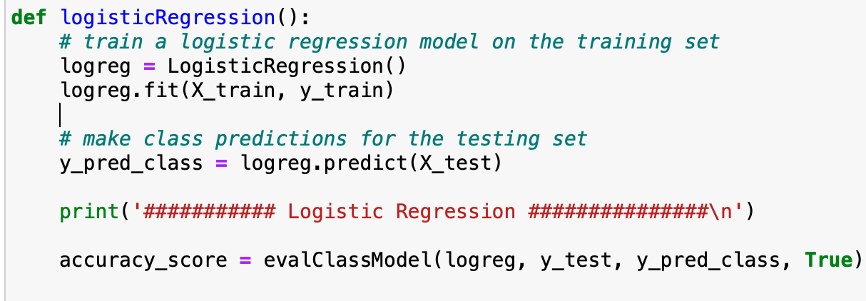
Logistic, Random Forest, Decision Tree classifier
Models are trained on the training set and predictions are made on the testing set.
Logistic regression model was applied to the training data set and accuracy was found out.
Similarly accuracy of random forest modelling was performed, and accuracy was found.
Decision tree classification was also performed on the data set.
In similar fashion , training was done using decision tree modelling technique on the split training data set.
Accuracy score was calculated after prediction of testing set.

Slide 14
Confusion matrix
A confusion matrix is a table that is often used to describe the performance of a classification model (or “classifier”) on a set of test data for which the true values are known. It allows the visualization of the performance of an algorithm.
Used to evaluate quality of the output of a classifier on the data set.
True positive (TP),True negative (TN),False negative (FN), False positive(FP)
Accuracy metric: It’s the ratio of the correctly labeled subjects to the whole pool of subjects. Accuracy = (TP+TN)/(TP+FP+FN+TN)

Slide 15

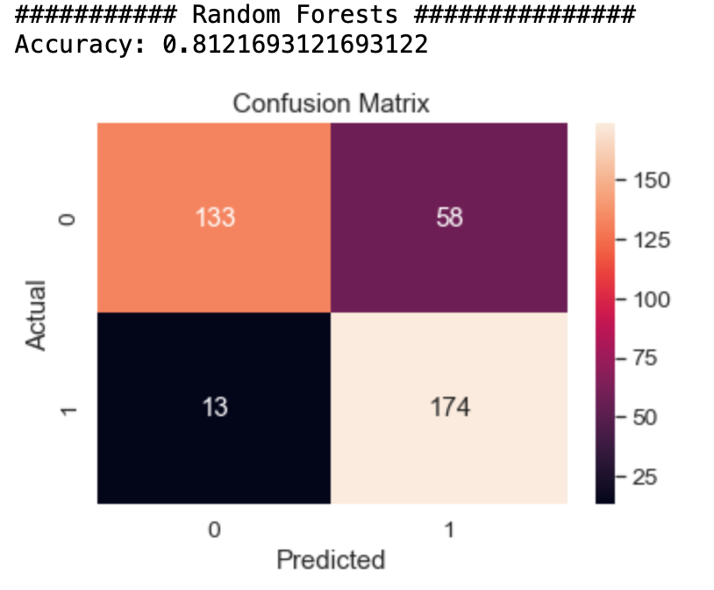
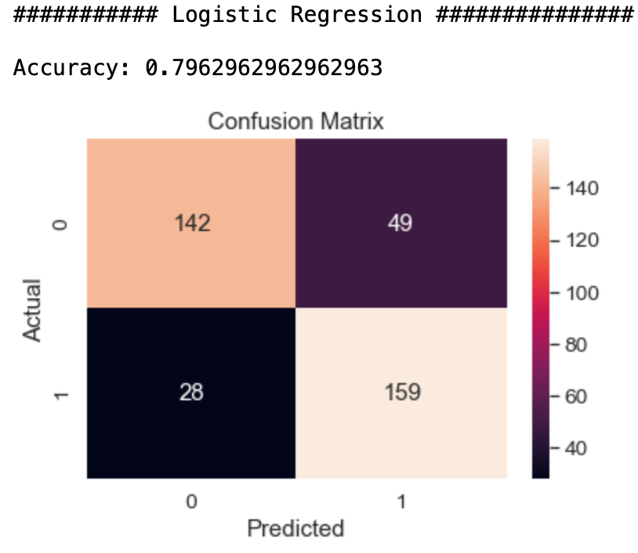
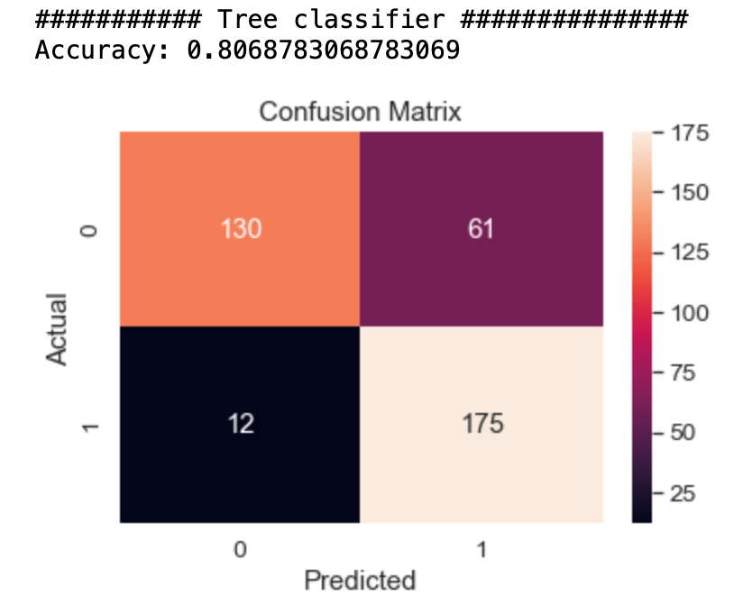
Accuracy Comparision

Slide 16

Thank YOU!

